Slide 1
State Road (SR) 7/US 441 from South of Stirling Road to North of Orange Drive and SR 7 (US 441) from SW 21st Street to NW 3rd Street Resurfacing, Restoration and Rehabilitation (RRR) Project Broward County, Florida
Project Identification Number: 447676-1-52-01 and 447677-1-52-01
Public Meeting | May 24, 2023
Notes:
Hello and welcome to the public meeting for State Road 7 (US 441) from South of Stirling Road to North of Orange Drive and State Road 7 (US 441) from Southwest 21st Street to Northwest 3rd Street Resurfacing, Restoration and Rehabilitation Project in Broward County, Florida. Financial Project Identification Number: 447676-1 and 447677-1. Today is May 24, 2023 and the time is 6:00 p.m.

Slide 2
Agenda
Introductions
Technical Information
Non-Discrimination Policy
Rules of Engagement
FDOT Safety Message
Project Overview
Design Plans
Maintenance of Traffic
Questions and Answers
Contact Information
Notes:
The Agenda for the meeting tonight is as follows:
Introductions
Technical Information
Non-Discrimination Policy
Rules of Engagement
FDOT Safety Message
Project Overview
Design Plans
Maintenance of Traffic
Questions and Answers
Contact Information

Slide 3
1. Introductions

Slide 4
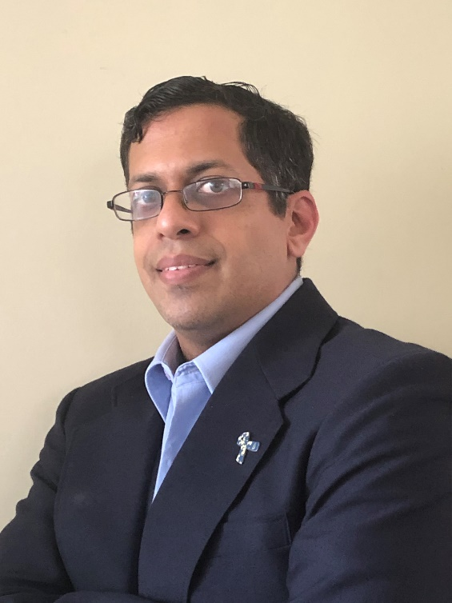
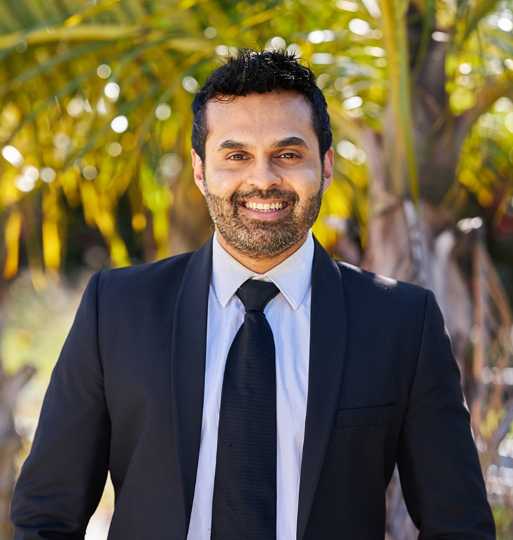
Project Team
Robert Lopes, PE
Project Manager
Florida Department of Transportation
Manosh Varghese, PE
Consultant Project Manager
Metric Engineering
Notes:
Joining us this evening are members of the State Road 7/US 441 project team: Robert Lopes, Project Manager, Florida Department of Transportation and Manosh Varghese, Consultant Project Manager, Metric Engineering

Slide 5
2. Technical Information

Slide 6
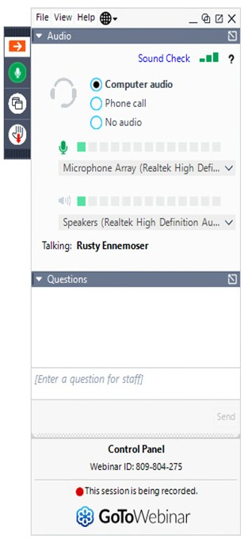
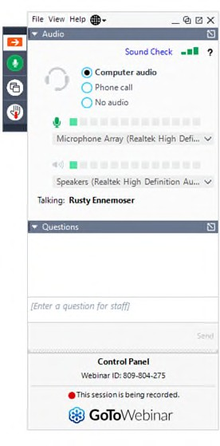
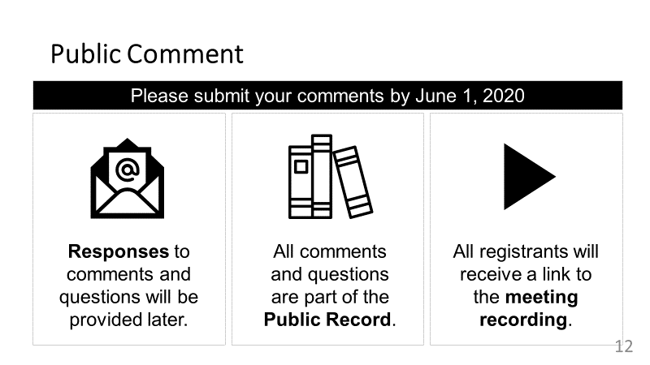
Participating on GoToWebinar
Notes:
Before we begin the project presentation, we would like to share a few items to help online attendees participate in this meeting.
If you are using GoToWebinar on your computer or mobile device, you should see a control panel that looks like this.
The default audio setting will play sound from your computer or device speakers.

Slide 7
To report a technical issue…
All attendees will be placed in ‘Listen Only’ mode throughout the meeting.
?
Type in Question box on GoToWebinar Control Panel
Call
1 (850) 845-0082
Notes:
All attendees will be placed in Listen Only mode throughout the meeting.
You can submit comments or questions by typing them into the Questions pane on the control panel.
Comments or questions can be submitted at any time during the meeting.
We will collect these and provide responses after the presentation.

Slide 8
Virtual Public Meeting - Public Notice
Property Owner/Tenant Letters
FDOT Website
Florida Administrative Register
Newspaper
Notes:
Public notice for this virtual public meeting, including information on how to access the meeting platform, was provided in flyers to property owners and tenants in the project area, a posting in the Florida Administrative Register, and advertisement in local newspapers.

Slide 9
3. Non-Discrimination Policy

Slide 10
Non-Discrimination Policy
Stefan Kulakowski
stefan.kulakowski@dot.state.fl.us
11
Notes:
This meeting is being conducted in accordance with the Civil Rights Act of 1964. Public participation is solicited without regard to race, color, national origin, age, sex, religion, disability, or family status.
Persons wishing to express concerns about Title VI may do so by contacting the Florida Department of Transportation District Four Title VI Coordinator, Sharon SinghHagyan, or the state Title VI Coordinator, Stefan Kulakowski, at the contact information listed on the screen. This contact information is also included in the public notifications.

Slide 11
4. Rules of Engagement

Slide 12
Rules of Engagement
This Public Information Meeting is being recorded.
If you experience technical difficulties, please contact
+1 (850) 845-0082 so that a member of our technical support team may assist you.
All attendees will remain muted throughout the meeting.
At the end of the presentation attendees are also welcome to submit any questions/comments using the GoToWebinar Question Panel and a member of the team will respond.
?
Notes:
The public meeting is being recorded.
If you experience technical difficulties, please contact
1 (850) 845-0082 so that a member of our technical support team may assist you.
All attendees will remain muted throughout the meeting.
At the end of the presentation attendees are also welcome to submit any questions/comments using the GoToWebinar Question Panel and a member of the team will respond.

Slide 13
5. FDOT Safety Message

Slide 14
FDOT Safety Message
Notes:
FDOT Safety Message is “Work Zone Safety: It’s Everyone’s Job”

Slide 15
FDOT Safety Message
Notes:
FDOT Safety Message is “Work Zone Safety: It’s Everyone’s Job”
Watch
Be Aware
Slow Down
Save Lives

Slide 16
6. Project Overview

Slide 17
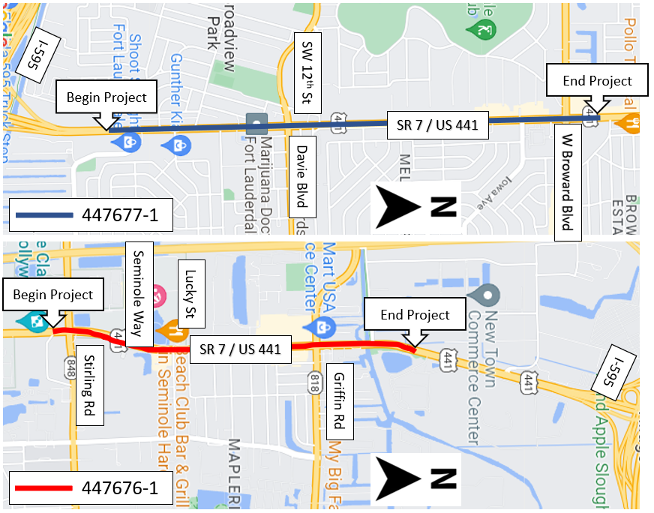
Project Location
Notes:
This project is located in Broward County and consists of two financial project IDs. 447677-1 is State Road 7 (US 441) from Southwest 21st Street to Northwest 3rd Street and 447676-1 is State Road 7 (US 441) from South of Stirling Road to North of Orange Drive

Slide 18
7. Design Plans

Slide 19
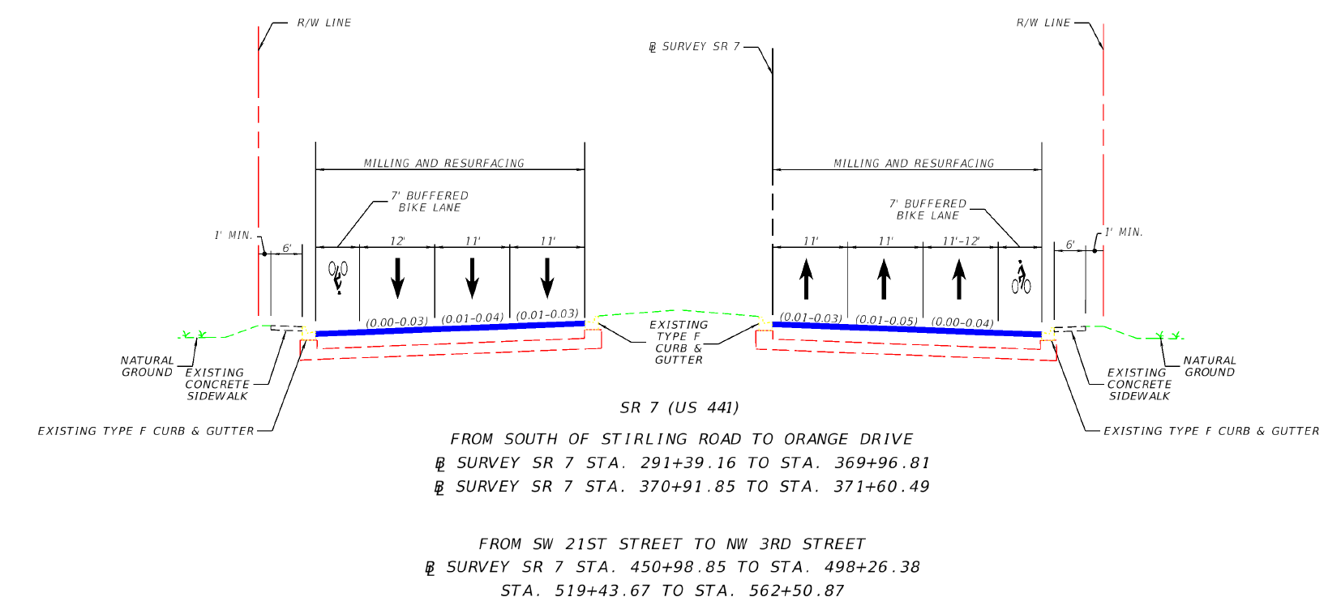
Proposed Roadway Concept
447676-1 / 447677-1
Notes:
The limits of both projects will be resurfaced to repave the existing roadway. The roadway consists of 3 travel lanes and a bike lane in each direction. The striping of the lane lines will be configured to allow for 7’ buffered bike lanes and a wider outside lane for transit from South of Stirling Road to Orange Drive and from SW 21st Street to NW 3rd Street.

Slide 20
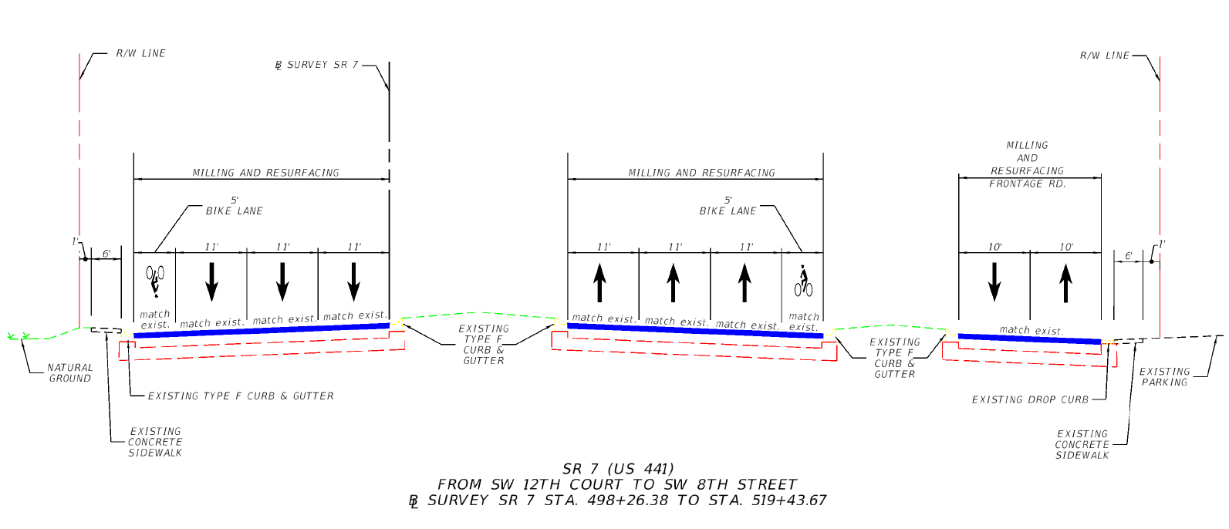
Proposed Roadway Concept
447677-1 – Frontage Road
Notes:
The same will be done for the frontage road on 447677-1, SR 7 (US 441) from SW 12th court to SW 8th street.

Slide 21
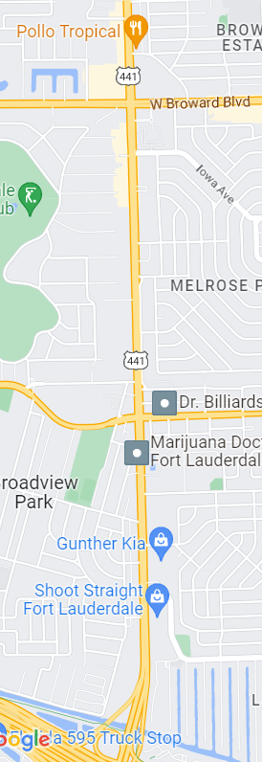
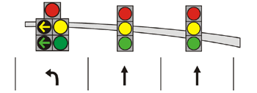
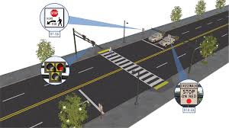
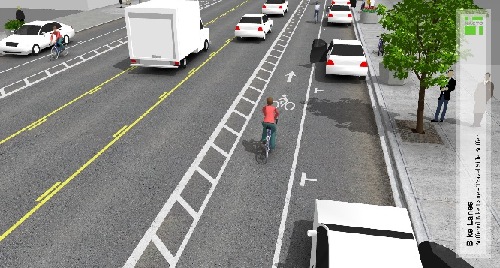
Proposed Project Safety Enhancements
Adding signal head per lane
I-595
SW 21st St
SW 12th St
NW 3rd St
Adding signalized midblock crossing at SW 16th St (447677-1)
SR 7 / US 441
SW 16th St
Davie Blvd
W Broward Blvd
447677-1
Widening bike lanes to add buffer
Notes:
Both projects have several safety improvements intended to reduce crashes and encourage bicycle and pedestrian mobility, these improvements include measures such as adding a signal head per lane for each approach at the intersections of Seminole Way and SW 51st St. Based on existing pedestrian crossing volumes it has been determined to add a signalized midblock crossing at the intersection of SW 16th St. Bike lanes will be enhanced by adding a buffer, increasing the bike lane width from 5’ to 7’.

Slide 22
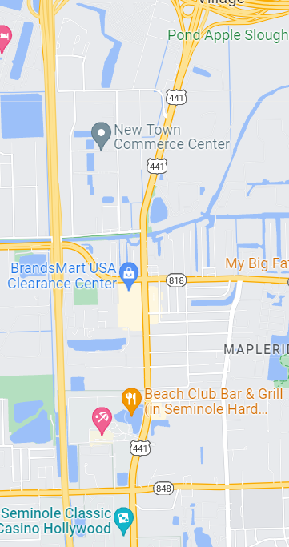
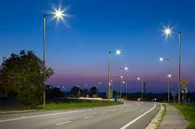
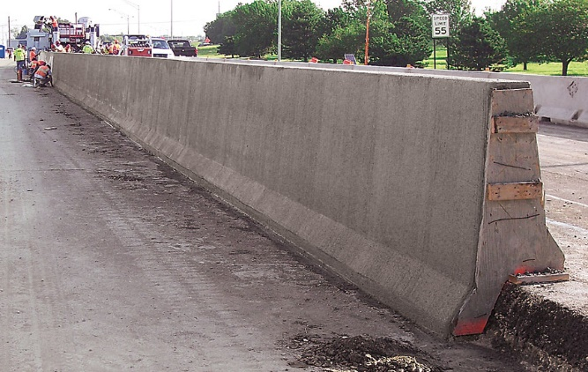
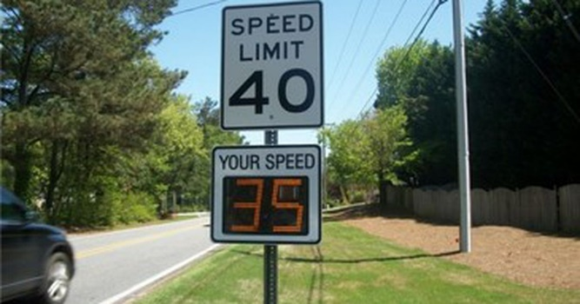
Proposed Project Safety Enhancements
Adding/upgrading lighting to LED throughout 447676-1 project limits.
Seminole Way
Lucky St
Orange Dr
Adding barrier wall adjacent to canal south of Orange Dr.
SR 7 / US 441
Stirling Rd
I-595
Griffin Rd
447676-1
Adding speed feedback signs north of Stirling Rd.
Notes:
Project 447676‐1 will also upgrade the existing lighting to LED from North of Stirling to south of Griffin Rd to better meet required illumination levels, railing along the canal just south of Orange Dr will be upgraded by removing the existing pedestrian handrail and a crash‐worthy rigid barrier will be installed in its place, and speed feedback signs will be installed north of Stirling Rd on both NB and SB approaches as a traffic calming measure.

Slide 23
8. Maintenance of Traffic

Slide 24
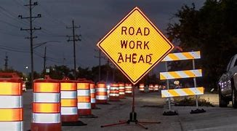
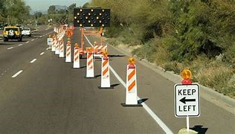
Maintenance of Traffic
All work will be done in phases to reduce the impact of construction to the community.
Temporary lane closures will occur during non-peak hours.
There will be no complete road closures.
Access to businesses and residences will be maintained at all times.
Notes:
All roadway work will be done in phases to reduce the impacts of the construction to the community. Any necessary temporary closures will be during non-peak hours. Access will be maintained to all businesses and residences along the corridor at all times.

Slide 25
Project Schedule and Cost
90% Plans Submittal:
September 2023
100% Plans (Design Complete):
January 2024
Bid Opening (Letting):
August 2024
Anticipated Construction Start:
Summer 2024
Anticipated Construction Completion:
Summer 2025
Construction Cost Estimate:
447676‐1 – $2.7 million
447677‐1 – $3.0 million
Notes:
Regarding the schedule and cost of the project, the 90% plans will be submitted in September 2023 and 100% plans will be January 2024. Construction is anticipated to begin the summer of 2024 and to be completed summer of 2025. The estimated construction cost for these projects is $2.7 million for 447676-1 and $3 million for 447677-1.

Slide 26
9. Questions and Answers

Slide 27
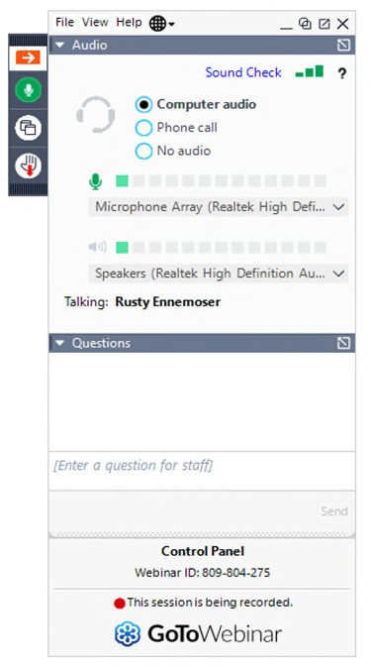
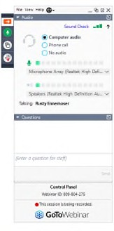
Submitting Comments or Questions
Online Participants
Written – Type in Question Box on Control Panel on the right side of your screen.
Phone Participants
Use your telephone to call: 1-(631) 992-3221
Access Code: 757-584-836
Notes:
At this moment we will go ahead and start the Question & Answer period.
All comments and questions submitted through these options are part of the public record for this virtual meeting and will be considered by the Department during project decision-making
To provide a comment, please use the “Question” button to text your question on your Go To Webinar Panel. Please provide your full name and email address, then your comment.
If your question is not responded to during the event, a response will be provided in writing following the virtual workshop.

Slide 28
Additional Comments & Questions
Please submit your comments by June 5, 2023
If your question was not responded to during the event, our project team will follow up with you.
All comments and questions are part of the Public Record.
All registrants will receive a link to the meeting recording and presentation slides.
Notes:
You may also submit comments after today’s meeting. Comments may be submitted to FDOT Project Manager Robert Lopes via mail, email, telephone, or through the website.
All comments receive or postmarked by June 5th, 2023 will become a part of the official public record.

Slide 29
10. Contact Information

Slide 30
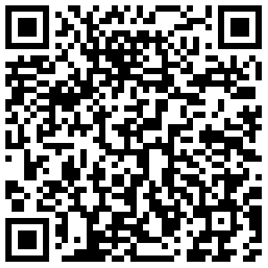
Contact Information
Please Contact Mr. Robert Lopes, PE, FDOT Project Manager
1. Robert.Lopes@dot.state.fl.us
2. Robert Lopes, PE FDOT District Four
3400 West Commercial Boulevard Fort Lauderdale, FL 33309
3. (954) 777-4425 or
Toll Free: (866) 336-8435; Ext. 4425
To download presentation slides, use the link
and/or scan the QR code.
Notes:
Comments may be submitted to FDOT Project Contact Robert Lopes via mail, email, telephone, or through the website listed on this slide.

Slide 31
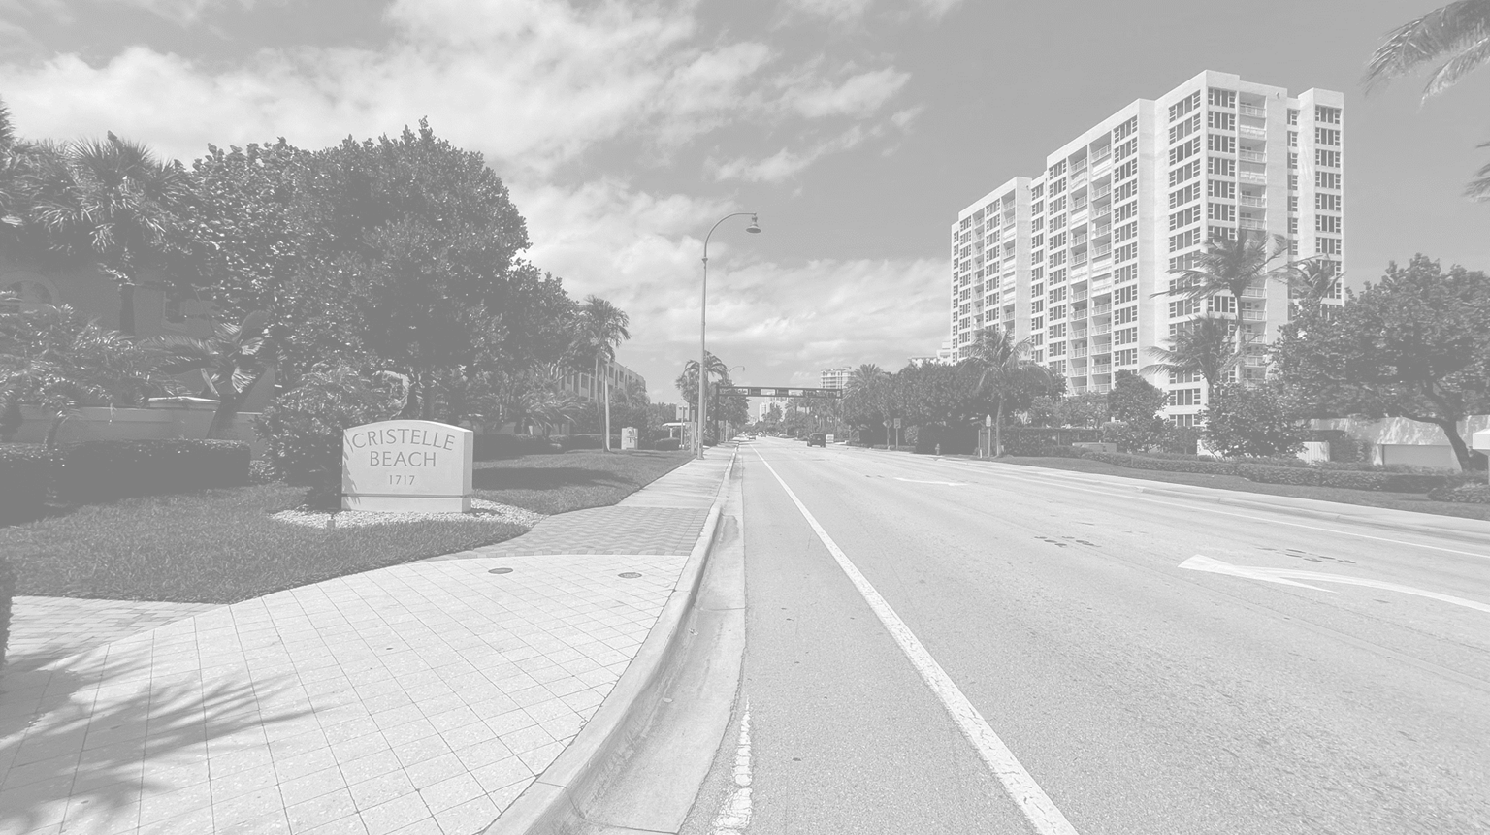
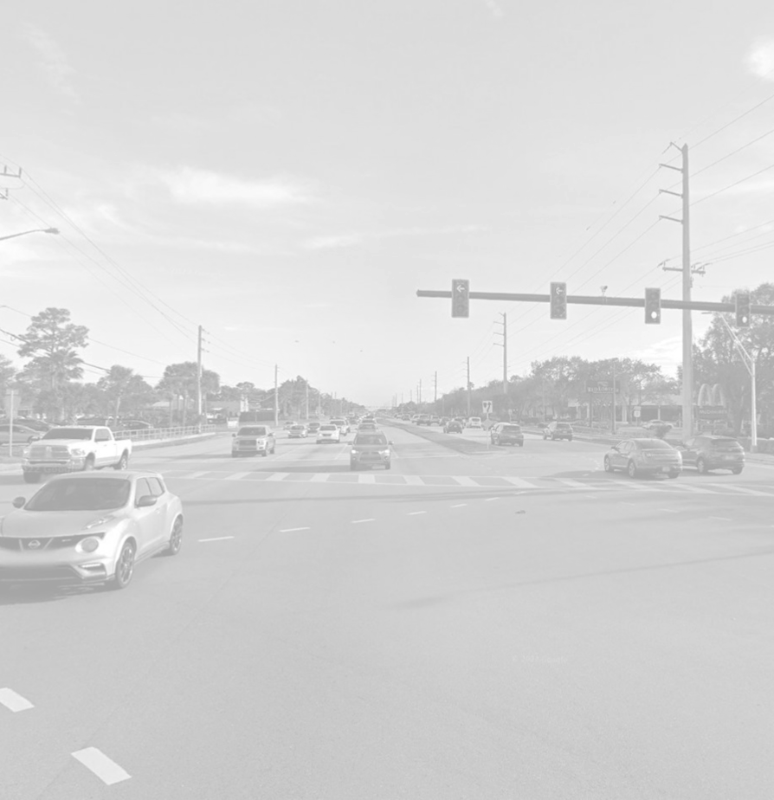
Thank you for attending today’s Public Information Meeting on the State Road (SR) 7/US 441 from south of Stirling Road to north of Orange Drive, and from SR 21st Street to NW 3rd Street
Resurfacing, Restoration and Rehabilitation (RRR) Project!
31
Notes:
Thank you for your participation.
The presentation will now replay for anyone who arrived after the initial presentation began.
Any questions that have not been answered, will be answered after the presentation replays.

